Slide 1
MA Outline
Peter Okelmann
Supervisor: Jörg Thalheim

Slide 2
Motivation
Lambdas/Serverless Requirements:
fast boot times
small runtime overhead
untrusted code from different parties
=> small boot images
=> containerization + virtualization
=> small containerization/virtualization services

Slide 3
Motivation
Inaccessible Lambdas:
Small boot images
  Almost no userland
  No debugging
  Difficult profiling
  No security inspection
Isolation: containerization + virtualization
  Small interface: guest ⇔ hypervisor
Small containerization/virtualization services
  Offers no interactive shells
=> Accessibility through VMSH

Slide 4
Use cases
Interactive Debugging:
  Big userland supported
  No interaction with the guests userland
Status Probing:
  Linux-perf profiling lambdas
  Attaching monitors like Prometheus
  Security scanning
Error Tracing:
  Record request traces in selected pods
  Less invasive than X-Trace

Slide 5
Problem Statement
Accessibility for Devs:
Interactive debugging
Status probing
Error tracing
Design Goals:
Isolation-platform agnostic
Hypervisor debugging
For serverless lambda deployments
=> create demo & evaluation system

Slide 6
Design
Pod / uVM / lambda
Build evaluation system:
VMSH
Serverless: firecracker [4], kubernetes, vhive [10]
Limitations:
KVM based hypervisor
Linux based VM image
DEBUG CONTAINER
shell
/
/var/lib/vm
/
Host or VM
vmsh
vsock
virtio-fs
/
User
Author: Joerg Thalheim

Slide 7
Design: Eval System
Controller
Pod/uVM
Pod / uVM / lambda
DEBUG CONTAINER
1. failure notification
shell
/
/var/lib/vm
/
kubectl
Host or VM
vmsh
vsock
virtio-fs
/
2. attach to uVM
User / Debugger / Prober

Slide 8
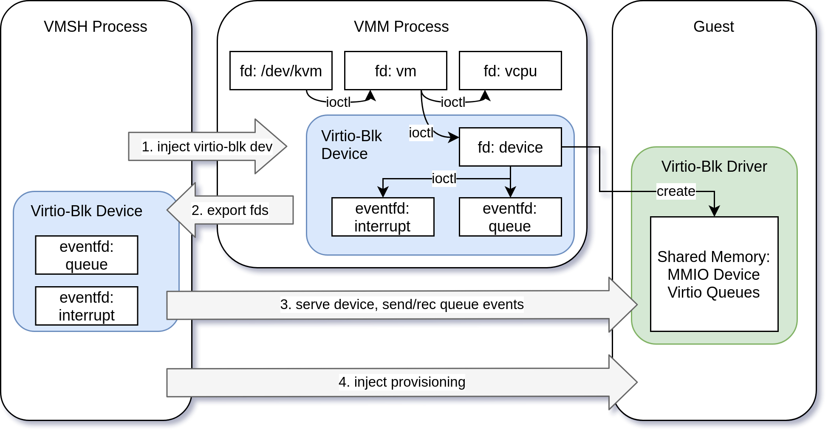
Implementation: Virtio-Blk
Notes:
start a firecracker-independent virtio-blk process (vmsh) @host
kvm-pirate the smallGuest @host
add virtio device to kvm @host
inject code to start the virtio-blk driver @smallGuest
set up debugging container @smallGuest
connect host some console to debugging container

Slide 9
Evaluation
Building slim versions and comparing them:
  App provisioning from ansible-galaxy
  Vagrant boxes: only contain distro images
Performance evaluation
  Use cases
    Debugging
    Probing
    Tracing
  Measurements: naive big VM vs vmsh+uVM
    Use case performance
    Impact of use case on guest (invasiveness)
    Startup performance
Security: Principle of least privilege

Slide 10
Related Work
Evaluation of Cntr [1]
  Phoronix Test Suite
  Docker tiny
Introspection
  Cntr: needs containerd-firecracker
  X-Tier: VM introspection (for security scanners) [3]
  Exterior: Introspection with secure VM [2]
  KVM profiling: perf kvm
Lambda Environments:
  For eval: kubernetes, vhive [10], some open alternatives [11]
  Firecracker [4], how to build elastic VMs for lambdas [12]
  Cntr for container(d) based runtimes: docker, SAND [9]
Tracing: Canopy [5], X-Trace [8], Dapper [6], Magpie [7]

Slide 11
Sources
[1] Cntr: Lightweight OS Containers, Usenix ATC Proceedings, 2018
[2] EXTERIOR : Using a Dual-VM Based External Shell for Guest-OS Introspection, Configuration, and Recovery, VEE, 2013
[3] X-TIER: Kernel Module Injection, NSS Proceedings, 2013
[4] Firecracker: Lightweight Virtualization for Serverless Applications, Usenix NSDI Proceedings, 2020
[12] My VM is Lighter (and Safer) than your Container, SOSP, 2017
[10] Benchmarking, Analysis, and Optimization of Serverless Function Snapshots, ASPLOS Proceedings, 2021
[5] Canopy: An End-to-End Performance Tracing And Analysis System, SOSP, 2017
[6] Dapper, a Large-Scale Distributed Systems Tracing Infrastructure, Google, 2010
[7] Magpie: online modelling and performance-aware systems, HotOS IX Proceedings, 2003
[8] X-Trace: A Pervasive Network Tracing Framework, Usenix NSDI, 2007
[9] SAND: Towards High-Performance Serverless Computing, Usenix ATC Proceedings, 2018
[11] An evaluation of open source serverless computing frameworks, IEEE CloudCom Proceedings, 2018

Slide 12
Thanks!
Questions?

Slide 13
Preliminary Schedule
15-02: Begin
15-03: virito-blk done
15-07: Complete Paper Draft, do eval?
01-08: Start revising the Draft
15-08: Final Deadline

